Slide 1



Learning F#
By Designing Your Own Language!
Speaker: Alexey Golub
@Tyrrrz

Slide 2
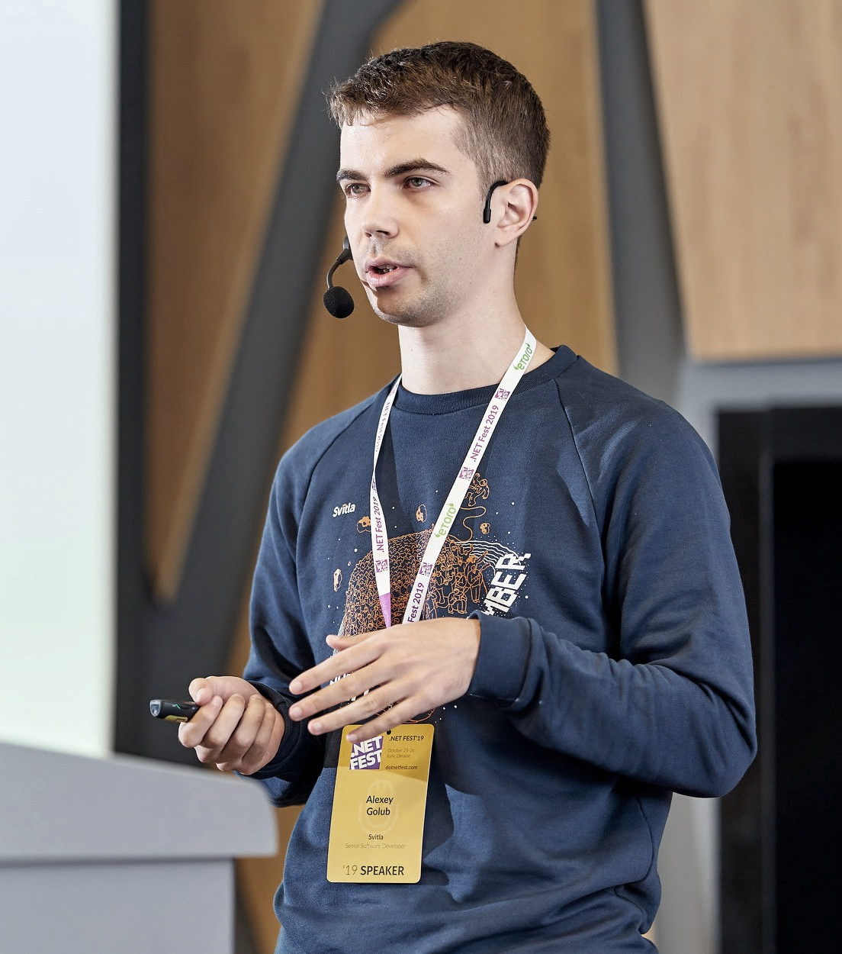
/whois ${speaker}
Open-source developer ✨
Conference speaker & blogger 🌐️
C#, F#, JavaScript 💻
Cloud & web ☁️
Automation & DevOps ⚙️
Speaker: Alexey Golub
@Tyrrrz

Slide 3
What is F#?
Functional-first language for .NET
General purpose & multi-paradigm
Strongly-typed with powerful type inference
Open source @ fsharp.org
Speaker: Alexey Golub
@Tyrrrz

Slide 4
What can F# be used for?
Anything, really
Web development (Fable, Elmish, Bolero, Giraffe, Suave, Saturn)
Desktop development (Avalonia.FuncUI, Elmish.WPF, WinForms)
Mobile development (Fabulous, Xamarin, Elmish.React)
Data access (Type providers, FSharp.Data, Rezoom.SQL)
Data science (Jupyter, FsLab, XPlot, Deedle, Math.NET, ML.NET)
Speaker: Alexey Golub
@Tyrrrz

Slide 5
What?!
lambda calculus
lenses
sum type
generic operators
nominal typing
hindley-milner type system
monad
category theory
catamorphism
return type inference
pure-impure segregation principle
computation expression
return type inference
isomorphism
side-effect
functor
declarative vs imperative
higher-order polymorphism
Speaker: Alexey Golub
@Tyrrrz

Slide 6
Paradigm shift
Object-oriented programming
Functional programming
Objects encapsulate data + behavior
Contracts through interfaces and classes
Reusability through object composition
Primarily imperative
Favors mutability & state
Data and behavior are separate
Contracts through function signatures
Reusability through function composition
Primarily declarative
Favors immutability & purity
Speaker: Alexey Golub
@Tyrrrz
Notes:
Both C# and F# can be used to write code in either style, but F# makes it easier to write functional code

Slide 7

Functional Purity
Pure Function
Data In
Data Out
Impure
isWeekend() {
var date = now();
return date.weekday == Saturday ||
date.weekday == Sunday;
}
isWeekend(date) {
return date.weekday == Saturday ||
date.weekday == Sunday;
}
Domain is modelled as data and pure functions that transform it
Pure functions are composed to create data flow pipelines
Impure side-effects are pushed towards the edges of the system
Pure
Speaker: Alexey Golub
@Tyrrrz

Slide 8
Parsers are functional
Parser
Text
Syntax Tree
Parser Composition
(‘THEN’, ‘OR’, ‘REPEAT’, etc.)
‘a’
Parser A
Token.A
‘ab’
Token.A * Token.B
‘b’
Parser B
Token.B
Speaker: Alexey Golub
@Tyrrrz

Slide 9

FParsec
Library for building recursive-descent parsers
Lets us express grammar rules with functions
Parser is a function of input that returns produced result
Complex parsers are built by combining less complex parsers
Hierarchy of parsers resembles the target syntax tree
Incredibly fast performance
https://github.com/stephan-tolksdorf/fparsec
Speaker: Alexey Golub
@Tyrrrz

Slide 10
Let’s build our own query language!
Speaker: Alexey Golub
@Tyrrrz

Slide 11
Language syntax
filterby Category = ’Fantasy’
orderby Rating desc
skip 5
take 10
[Statements…]
keywords
Filter
Order
Skip
Take
identifiers
literals
Expression
Expression
Expression
expressions
statements
Expression
Direction
Speaker: Alexey Golub
@Tyrrrz

Slide 12
Language syntax
Expression
Integer literal (int)
Float literal (float)
String literal (string)
Identifier (string)
Binary (expression * expression * kind)
Speaker: Alexey Golub
@Tyrrrz

Slide 13
Operator precedence parser
Automatically parses recursive operators
Supports infix, prefix, postfix, and ternary operators
Handles associativity and precedence rules
type OperatorPrecedenceParser<'TTerm, 'TAfterString, 'TUserState> =
member ExpressionParser: Parser<'TTerm,'TUserState>
member TermParser: Parser<'TTerm,'TUserState> with get, set
member AddOperator: Operator<'TTerm, 'TAfterString, 'TUserState> -> unit
member RemoveOperator: Operator<'TTerm, 'TAfterString, 'TUserState> -> bool
Speaker: Alexey Golub
@Tyrrrz

Slide 14
Things we’ve learned
F# syntax & project structure
Data types, records, discriminated unions, tuples
Pattern matching
Function composition
Writing language parsers
Speaker: Alexey Golub
@Tyrrrz

Slide 15
Source code
https://github.com/Tyrrrz/JetBrainsDotnetDay2020
Contains the demo project and the presentation
Speaker: Alexey Golub
@Tyrrrz

Slide 16
Learn more
F# for Fun and Profit by Scott Wlaschin https://fsharpforfunandprofit.com
FParsec tutorial by Stephan Tolksdorf https://quanttec.com/fparsec/tutorial.html
Parsing in F# with FParsec by Alexey Golub https://tyrrrz.me/blog/parsing-with-fparsec
Speaker: Alexey Golub
@Tyrrrz

Slide 17
Thank you!
Speaker: Alexey Golub
@Tyrrrz

